Slide 1
Modern Education Society’s College of Engineering SE-COMP2
Title: Supermarket Billing System.
Team:
1.Nikhil Giramkar
2.Rehan Shaikh
3.Rupesh Bodkhe
4.Shubham Rane

Slide 2
Problem statement:
Develop a Supermarket Billing System using C++.The key Features of this application are listed below:
*Billing Report: It shows the bill report of all the items added in supermarket billing system.
*Add, Remove or Edit Items: With this feature one can add, remove and modify item details. In add items, one can add information or details such as item no., item name, manufacturing date, price, quantity,etc.
*Show item details: This feature allows the users to see the items and the corresponding details given for the item while adding the item.
Use file to store data.

Slide 3
OBJECTIVE:
To give a dynamism to the orthodox billing systems using OOPs
features.
To imitate a Supermarket Billing System.
To simplify the task of Shopkeepers/Cshier at a Supermarket by
introducing such system.
To bring a change in the typical markets by garnishing them with
programming abilities of CS Engineers.
Provide a user-friendly approach while handling the software for
customer as well as staff.

Slide 4
METHODOLOGY:
Extensive use of Object Oriented Programming features such as:
1. Encapsulation.
2. Data Hiding.
3. File handling.
4. Inheritance.
5. Extensive use of Data Structures features such as:
a. Pointer objects of array.
b. Default Constructors.
c. new, this and delete keywords.
d. Iteratives loops.
6. Menu Driven programming.
Iclusion of Standard libraries such as:
a.<iostream>
b. <iomanip>
c. <cstring>
d. <fstream>
e. <stdlib.h>

Slide 5
ALGORITHMIC APPROACH:
1. Start the program by including necessay libraries.
2. Create a class 'AdminLog'
a. Declare necessary variables.
b. Define necessary functions.
//Now create a function Admin_create()
//Set the deafult Username & Password for Shopkeeper as "admin";
//Now Create a function Admin_Login()
//Check whether the username and password entered by the user match
or not.(using strcmp)
//Display appropriate messages.
//Let the user access the data if credentials match.
3. Create a class 'Data'. //For data manipulative functions.
a. Declare necessary variables.
b. Define necessary functions.

Slide 6
//Define a default constructor to set all values to 0;
//Create a function input()
//Ask the user for Name, Unique Code, Stock position, Price of that item and
read the data;
//Create a function del()
//Compare the unique code stored and entered by the user and return 1 or 0;
//Create a function callBill()
//Ask the user qyantity of items he wishes to buy.
//Display Appropriate mssage if Out of Stock else show the bill;
//Create a display() function
//Display Items everytime in a generalised format.

Slide 7
4. In main function
a. Declare necessary variables.
b. Create objects of class 'data'
data *s[MAX];
data *cart[MAX];
5. Now predefine the details of items at display in the market
s[i]=new data;
s[i]->item="Onion";
s[i]->price=30;
s[i]->code="oni";
s[i]->stock=40;
i++;
Similarly define other items like Tomato, Potato, Carrot,
Capsicum,Cauliflower, Mushroom, Bottle Guard, Pear, Pomegranate,
Cabbage, Cucumber, Bitter guard, Beamns, Brinjal, Pumpkin, Mint,
Spinach, Green Peas, Orange, Banana, Apple, Kiwi, Guava,etc.

Slide 8
6. Now give the user choices whether to:
1.Login as Customer.
2.Login as Shopkeeper.
//Accept user's Choice
cin>>ch;
if(ch==1) //Login as Shopkeeper/Admin.
{ //Create a do-while loop to perform continuos operations.
do{
/*Using switch case ask the user whether to:
1. Add Item.
2. Display Items.
3. Dlelete any item.
4. Goto Login Options (using labels)
5. Exit (from do-while lop) */
//Ask the the user one of the choices from above options and perform necessary
modules in switch-case.
cin>>ans;
switch(ans)
{
case 1: //Add Items
s[i]=new data;
s[i]->input();
i++;
break;

Slide 9
case 2: //Display Shop items
//Display all elements in for loop
s[i]->display(ch);
break;
case 3: //Enter unique code of item to be deleted.
/* Input the unique code as parameter to the 'del()' function.
If the item is deleted. Shift the items by one index behind.
Set the flag=1; */
if(flag==1)
//Item deleted.
else
//Item not found.
break;
case 4: goto Login;
break;
}
}while(ans!=5);
}

Slide 10
elseif (ch==2)
//Login as Customer
{
//In a do-while loop ask the user for choice
do{
/* Using switch case ask the user whether to:
0. Goto Login Page.
1. Display Items.
2. Search for an item and and to cart.
3. Delete an item from the cart.
4. Display Cart.
5. Checkout.
6. Exit. */
//Ask the user his choice.
cin>>ans;

Slide 11
switch(ans)
{ case 0: goto Login;
break;
case 1: //Display items in a for loop.
s[j]->display();
break;
case 2: //Enter unique code of item to be purchased.
/* Input the unique code as parameter to the 'del()' function.
If the item is added to cart, add that item as aparameter in bill
function.
Set the flag=1; */
if(flag==1)
bill=cart[k]->callBill(bill);
//Item Purchase.
else
//Item not found.
break;
case 3: //Enter unique code of item to be deleted.
/* Input the unique code as parameter to the 'del()' function.
If the item is deleted. Shift the items by one index behind.
Set the flag=1; */

Slide 12
if(flag==1)
//Item deleted.
else
//Item not found.
break;
case 4: //Display Items in cart
//Display all elements in for loop
cart[j]->display(ans);
break;
case 5: //The final bill is given in a printed format.
//Store the bill a seperate txt file using file handling.
//Create an object of class ofstream.
//Give away the bill & finally Transaction nd interaction with user ends here.
break;
}
}while(ans!=0);
}
delete s;
return 0;
//Main function Ends here....
7. Stop.

Slide 13
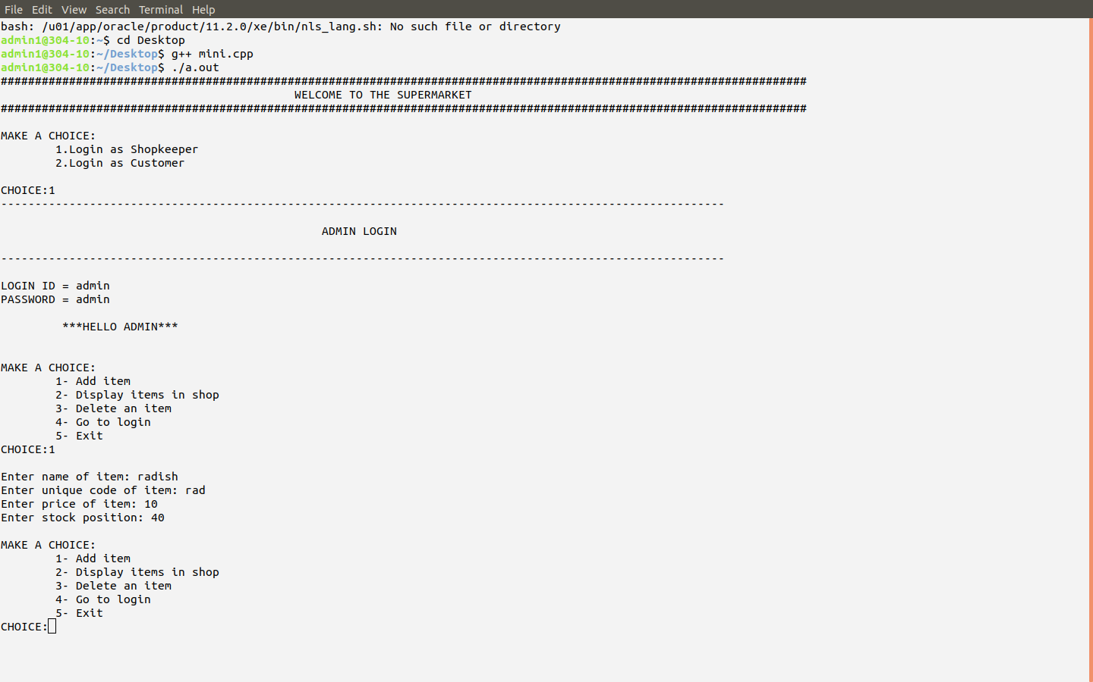
Output of the program:

Slide 14
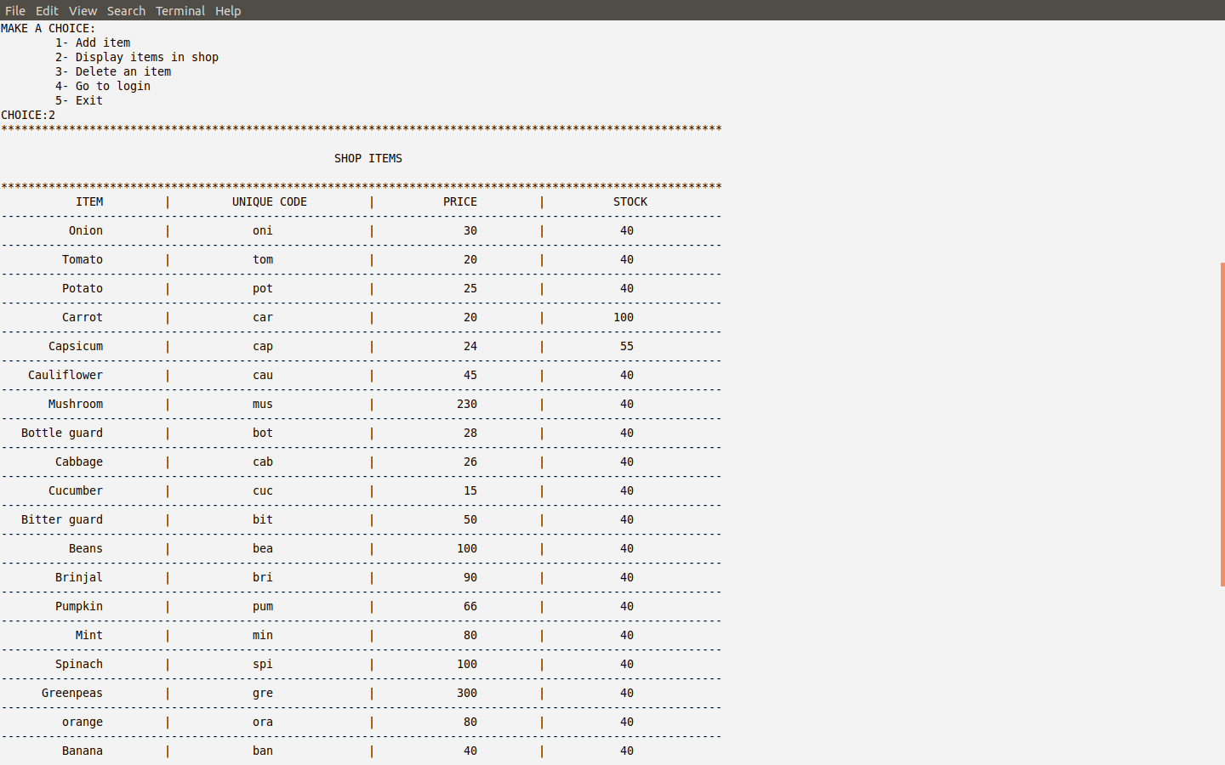

Slide 15
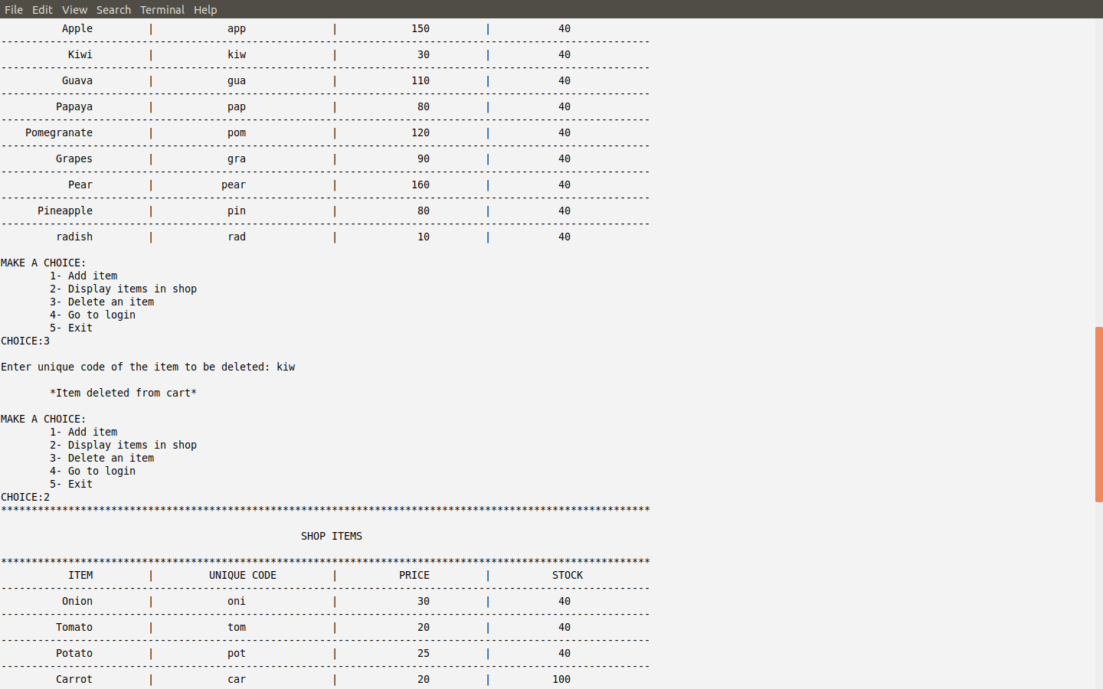

Slide 16
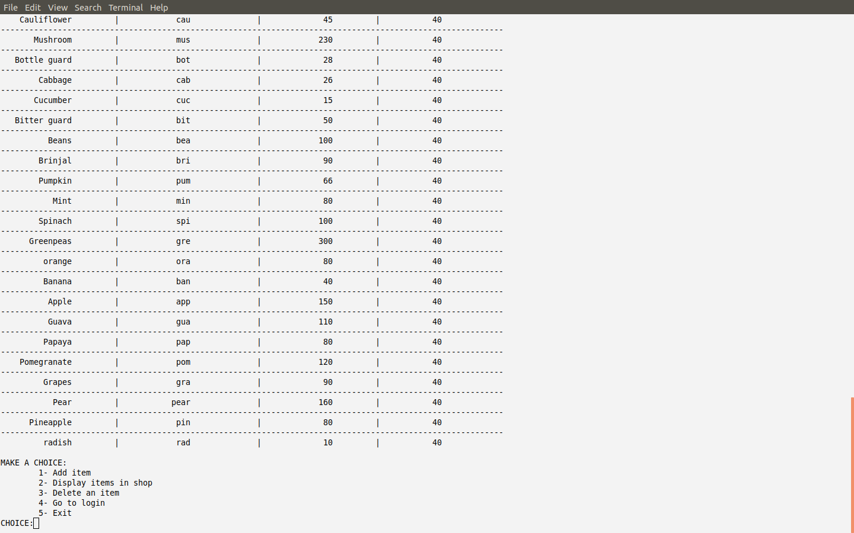

Slide 17
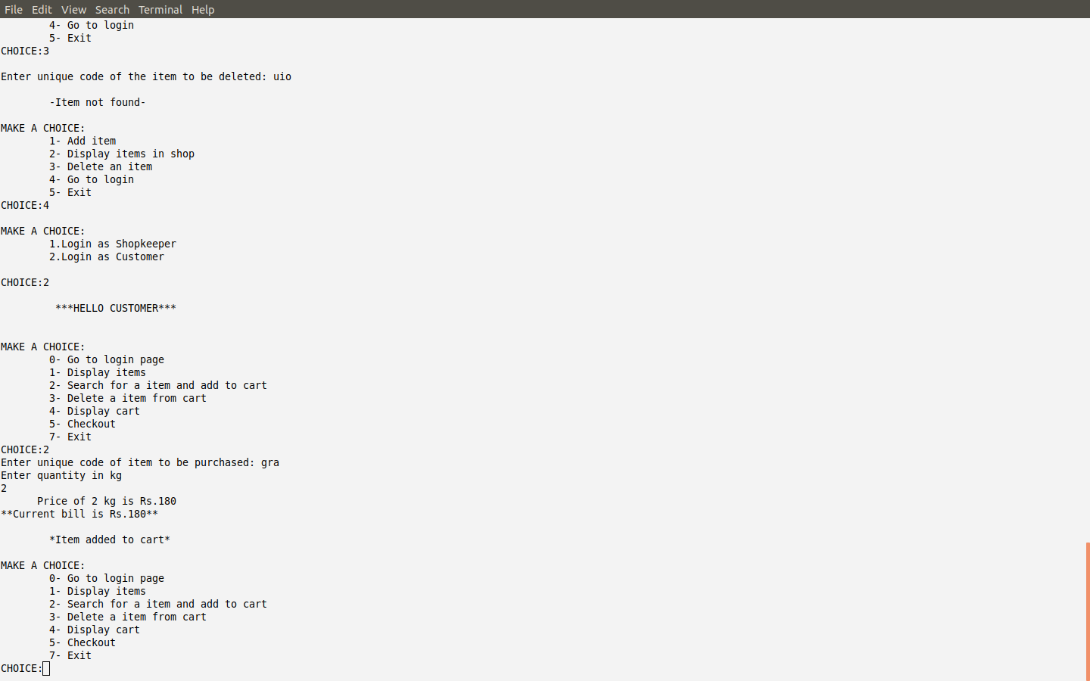

Slide 18
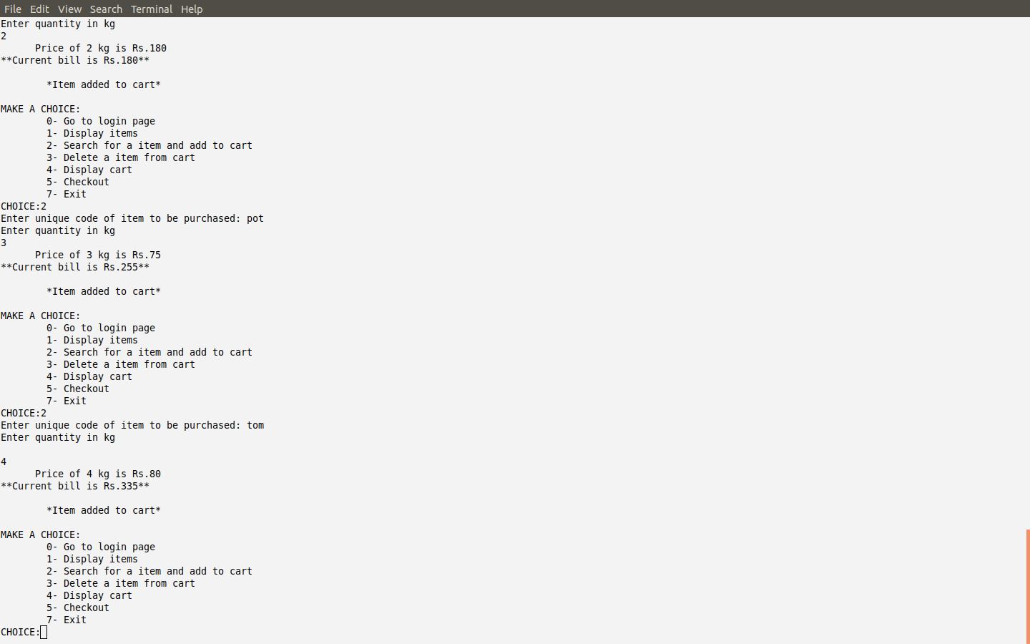

Slide 19
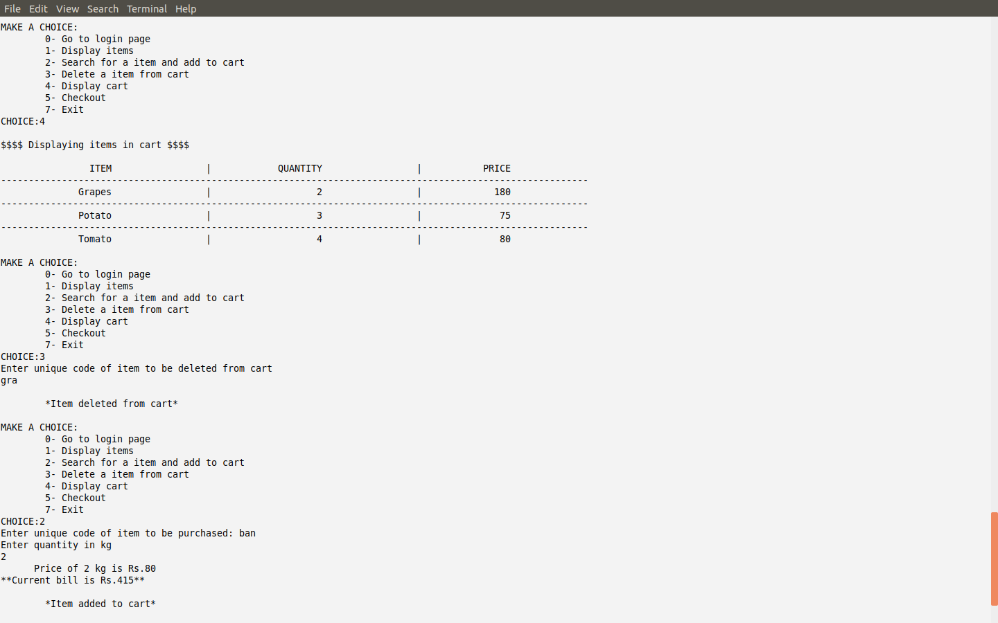

Slide 20
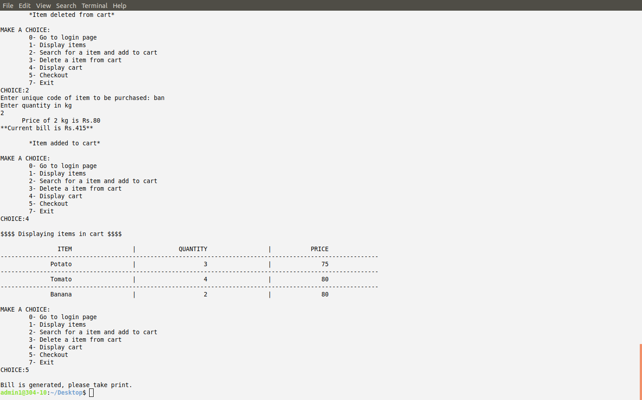

Slide 21
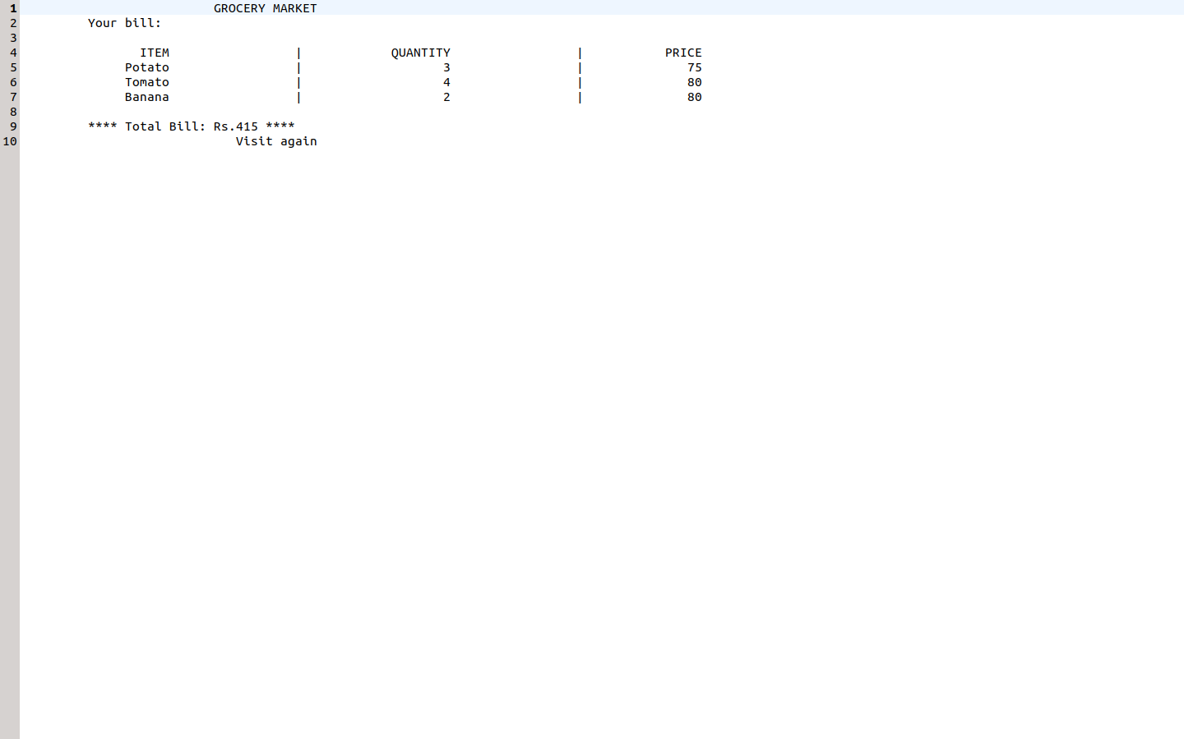

Slide 22
CONCLUSION:
The Mini Project to implement a Supermarket Billing Sysytem has been one of the bet experiences in Object Oriented Programming Languge Study.
Due to extensive use of OOPs features, I have mastered the subject and would be capable of implementing many such mini as well as major projects in future. This Mini project was a step towards Industrial application and training for Industrial manpower.
The project made above is solely unique and haven't been copied from any external resources.
Since this was a group project I would like to thank my fellow team members for their dedivtion an support throughout the project.
I would also thank our teacher Dr. J. R. Pansare Ma'am for her guidance.

Slide 23
THANK YOU.

